Slide 1


Coding Cat
Ahmad Subaktagin Jabir 16.02.04.061
Arunima Ayshee 16.02.04.066
Rahat Bin Osman 16.02.04.083
Aniqua Tabassum 16.02.04.085

Slide 2
Outline
Introduction
Names of Entities
Entity Relationship Diagram
Relational Model
Design of Three Pages
Conclusion
September 24, 2019
Coding Cat

Slide 3

Introduction
September 24, 2019
Coding Cat

Slide 4
It is important to store data of the users
Efficient data storing helps improve user experience
Will also help us recommend talents for suitable jobs
September 24, 2019
Coding Cat

Slide 5
Name of Entities
September 24, 2019
Coding Cat

Slide 6
Talents
Portfolio
Problems
Submission
Problem Setter
Assessment Test
Test History
Payment
Payment Type
September 24, 2019
Coding Cat

Slide 7
Project Manager
Interview
Search
September 24, 2019
Coding Cat

Slide 8
Entity Relationship (ER) Diagram
September 24, 2019
Coding Cat

Slide 9
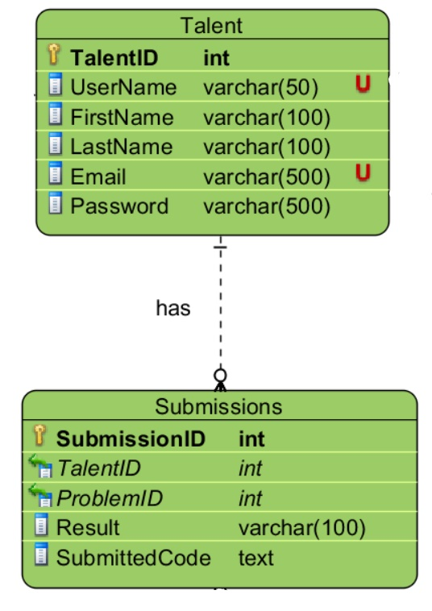
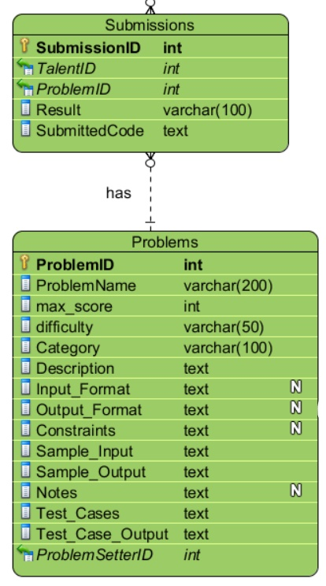
September 24, 2019
Coding Cat

Slide 10
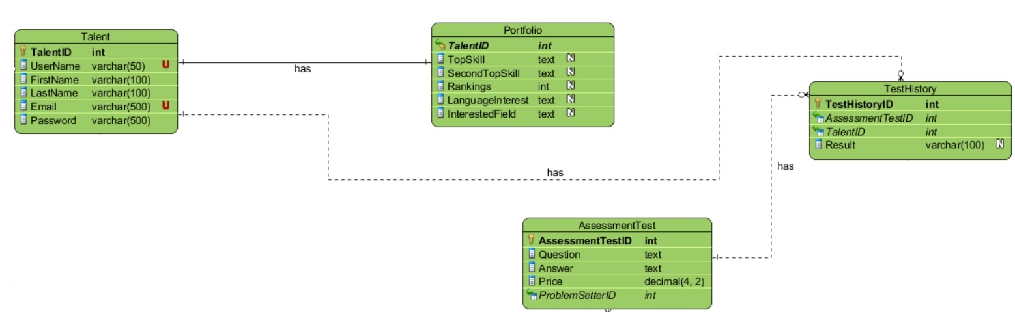
September 24, 2019
Coding Cat

Slide 11
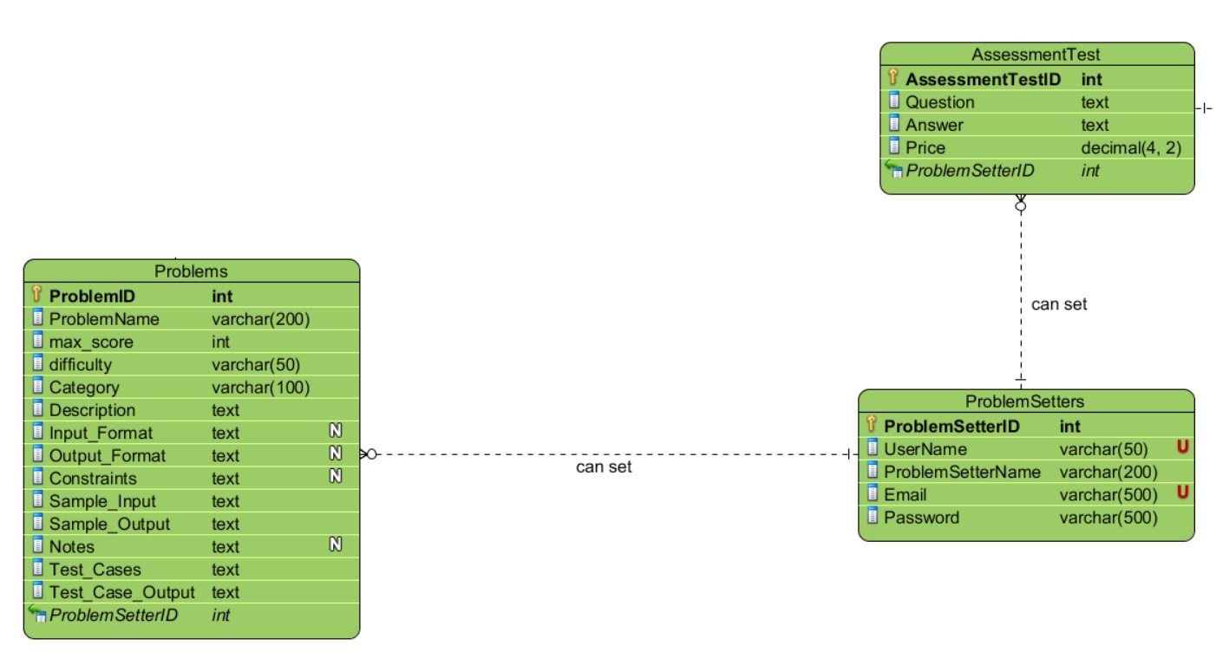
September 24, 2019
Coding Cat

Slide 12
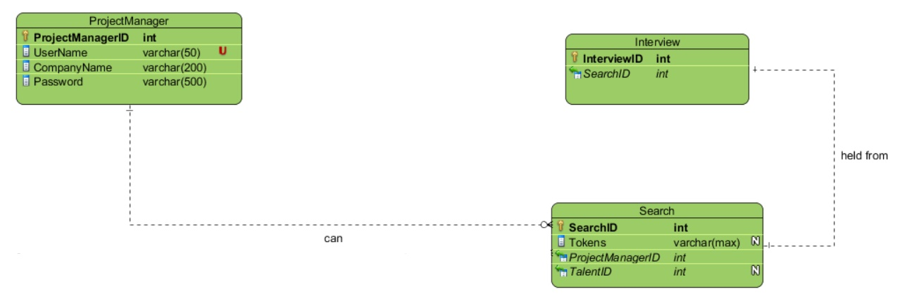
September 24, 2019
Coding Cat

Slide 13
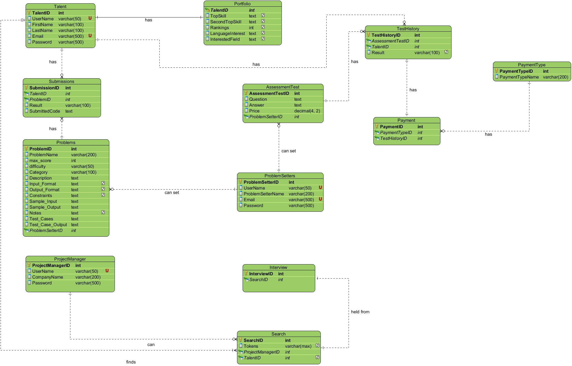
September 24, 2019
Coding Cat

Slide 14
Relational Model
September 24, 2019
Coding Cat

Slide 15
SQL Commands
September 24, 2019
Coding Cat

Slide 16
Talents | Portfolio
CREATE TABLE Talents ( TalentID int IDENTITY(1,1) NOT NULL, UserName varchar(50) NOT NULL UNIQUE, FirstName varchar(100) NOT NULL, LastName varchar(100) NOT NULL, Email varchar(500) NOT NULL UNIQUE, Password varchar(500) NOT NULL, PRIMARY KEY (TalentID)); | CREATE TABLE Portfolio ( TalentID int NOT NULL FOREIGN KEY REFERENCES Talents(TalentID), TopSkill text, SecondTopSkill text, Rankings int, LanguageChoice text, InterestedField text, PRIMARY KEY (TalentID));
September 24, 2019
Coding Cat

Slide 17
Problems | Submissions
CREATE TABLE Problems ( ProblemID int IDENTITY NOT NULL, ProblemName varchar(200) NOT NULL, max_score int NOT NULL, difficulty varchar(50) NOT NULL, Category varchar(100) NOT NULL, Description text NOT NULL, Input_Format text NULL, Output_Format text NULL, Constraints text NULL, Sample_Input text NOT NULL, Sample_Output text NOT NULL, Notes text NULL, Test_Cases text NOT NULL, Test_Case_Output text NOT NULL, ProblemSetterID int NOT NULL FOREIGN KEY REFERENCES ProblemSetters(ProblemSetterID), PRIMARY KEY (ProblemID)); | CREATE TABLE Submissions ( SubmissionID int IDENTITY (1,1) NOT NULL, TalentID int NOT NULL FOREIGN KEY REFERENCES Talents(TalentID), ProblemID int NOT NULL FOREIGN KEY REFERENCES Problems(ProblemID), Result varchar(100) NOT NULL, SubmittedCode text NOT NULL, PRIMARY KEY (SubmissionID));
September 24, 2019
Coding Cat

Slide 18
Problem Setters | Assessment Test
CREATE TABLE ProblemSetters ( ProblemSetterID int IDENTITY(1,1) NOT NULL, UserName varchar(50) NOT NULL UNIQUE, ProblemSetterName varchar(400) NOT NULL, Email varchar(500) NOT NULL UNIQUE, Password varchar(500) NOT NULL, PRIMARY KEY (ProblemSetterID)); | CREATE TABLE AssessmentTest ( AssessmentTestID int IDENTITY(1,1) NOT NULL, Question text NOT NULL, Answer text NOT NULL, Price decimal(4, 2) NOT NULL, ProblemSetterID int NOT NULL FOREIGN KEY REFERENCES ProblemSetters(ProblemSetterID), PRIMARY KEY (AssessmentTestID));
September 24, 2019
Coding Cat

Slide 19
Test History | Payment Type
CREATE TABLE TestHistory ( TestHistoryID int IDENTITY(1,1) NOT NULL, AssessmentTestID int NOT NULL FOREIGN KEY REFERENCES AssessmentTest(AssessmentTestID), TalentID int NOT NULL FOREIGN KEY REFERENCES Talents(TalentID), Result varchar(100), PRIMARY KEY (TestHistoryID)); | CREATE TABLE PaymentType ( PaymentTypeID int IDENTITY(1,1) NOT NULL, PaymentTypeName varchar(200) NOT NULL, PRIMARY KEY (PaymentTypeID));
September 24, 2019
Coding Cat

Slide 20
Payment | Project Manager
CREATE TABLE Payment ( PaymentID int IDENTITY(1,1) NOT NULL, PaymentTypeID int NOT NULL FOREIGN KEY REFERENCES PaymentType(PaymentTypeID), TestHistoryID int NOT NULL FOREIGN KEY REFERENCES TestHistory(TestHistoryID), PRIMARY KEY (PaymentID)); | CREATE TABLE ProjectManager ( ProjectManagerID int IDENTITY(1,1) NOT NULL, Company varchar(300) NOT NULL, UserName varchar(50) NOT NULL UNIQUE, Password varchar(500) NOT NULL, PRIMARY KEY (ProjectManagerID));
September 24, 2019
Coding Cat

Slide 21
Search | Interview
CREATE TABLE Search ( SearchID int IDENTITY(1,1) NOT NULL, Tokens varchar(max), ProjectManagerID int NOT NULL FOREIGN KEY REFERENCES ProjectManager(ProjectManagerID), TalentID int NOT NULL FOREIGN KEY REFERENCES Talents(TalentID), PRIMARY KEY (SearchID)); | CREATE TABLE interview ( InterviewID int IDENTITY(1,1) NOT NULL, SearchID int NOT NULL FOREIGN KEY REFERENCES Search(SearchID), PRIMARY KEY (InterviewID));
September 24, 2019
Coding Cat

Slide 22
Entities with Dummy Data
September 24, 2019
Coding Cat

Slide 23
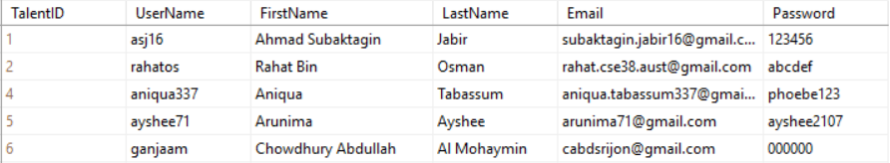
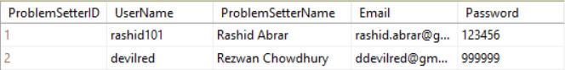
Talent
Problem Setter
September 24, 2019
Coding Cat

Slide 24
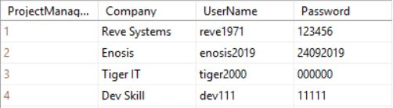
Project Manager
Problems
September 24, 2019
Coding Cat

Slide 25
Design of Three Pages
September 24, 2019
Coding Cat

Slide 26
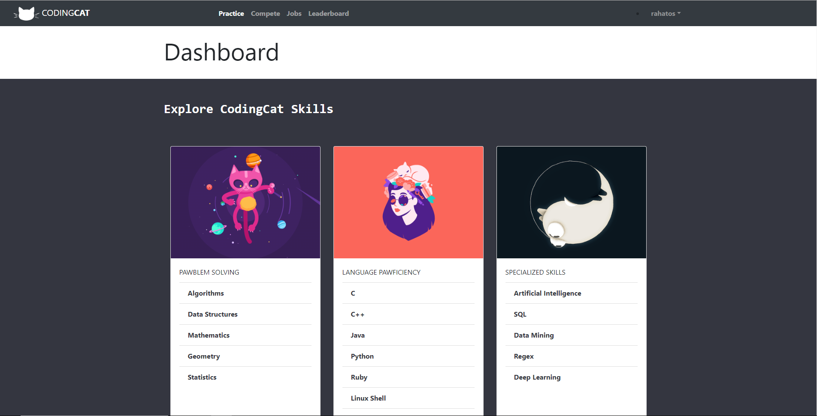
Home Page
September 24, 2019
Coding Cat

Slide 27
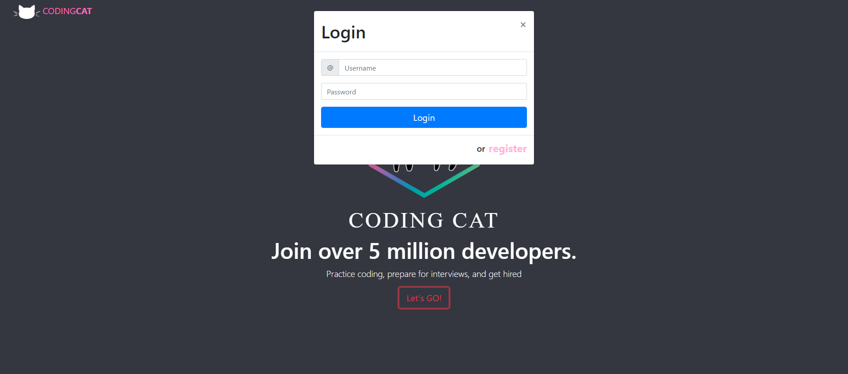
Login Page
September 24, 2019
Coding Cat

Slide 28
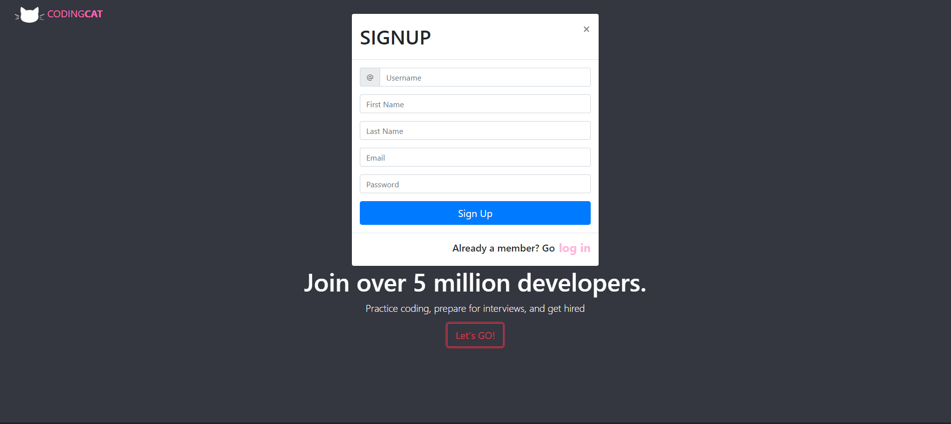
Registration Page
September 24, 2019
Coding Cat

Slide 29
Conclusion
September 24, 2019
Coding Cat

Slide 30

September 24, 2019
Coding Cat

Slide 31
ANY QUESTIONS?
September 24, 2019
Coding Cat

